Slide 1
Exploratory Data Analysis
Ted Laderas

Slide 2
What is Data Science?
Using data to make decisions or answer questions
Example: try and predict admitted patients who are at risk for readmission from electronic health records
Make focused decisions on their care to prevent readmission
Example: Are genomic variants in a gene predictive of disease in a larger population?
Should people with a genomic variant have a different treatment?

Slide 3
What are Data Science Skills?
Curiosity and a willingness to question dogma (Angela Bassa)
Domain knowledge
Data Importing and Cleaning
Exploratory Data Analysis (Data Detective Work)
Data Filtering and Querying
Statistics
Machine Learning
Communicating the story in the data (Data Storytelling)

Slide 4
Where can you get these skills?
Classes
BMI 569 - Data Analytics (OHSU)
Introduction to Scientific Computing Short Course
SYSC 435/535: Modeling and Simulation with R and Python
Workshops
R-Ladies PDX
PDX-R User Group
Conferences
Online Classes (Do as a group - find a cohort)
Chromebook Data Science
DataCamp (Cannot currently reccommend)

Slide 5
Our Overall Goal
Look at NHANES data
Understand how the variables are defined
Understand associations between outcome and variable
Understand interactions between variables
Share insights about the data with each other

Slide 6
What is NHANES and why are we looking at it?
National Health And Nutrition Examination Survey
Assess health/nutritional status of adults/children in the United States
Types of Survey Questions:
Demographic (Age, Race, Gender, many more…)
Socioeconomic (Marriage Status, Household Income, Education)
Dietary (Foods consumed, dietary supplements)
Health (Body Mass Index, Sleep Trouble, Depression)

Slide 7
Please Note
We’re not going to look at all of NHANES.
We’re looking at an extract from two years of the survey (which years?)
We’re ignoring how particpants were chosen/sampled from the larger population
We’ll talk a a little about this later.

Slide 8
What is a Data Dictionary?
Data Dictionary: a table where each variable in the dataset is defined.
Always ask for the data dictionary if it exists. Assume nothing!

Slide 9
NHANES Data Dictionary
VariableName | Definition
Age | Age in years at screening of study participant. Note: Subjects 80 years or older were recorded as 80.
AlcoholDay | Average number of drinks consumed on days that participant drank alcoholic beverages. Reported for participants aged 18 years or older.
BMI | Body mass index (weight/height2 in kg/m2). Reported for participants aged 2 years or older.
BMI_WHO | Body mass index category. Reported for participants aged 2 years or older. One of 12.0_18.4, 18.5_24.9, 25.0_29.9, or 30.0_plus.
BPSysAve | Combined systolic blood pressure reading, following the procedure outlined for BPXSAR.
Depressed | Self-reported number of days where participant felt down, depressed or hopeless. Reported for participants aged 18 years or older. One of None, Several, Majority (more than half the days), or AlmostAll.
Education | Educational level of study participant Reported for participants aged 20 years or older. One of 8thGrade, 9-11thGrade, HighSchool, SomeCollege, or CollegeGrad.
Gender | Gender (sex) of study participant,coded as male or female
HardDrugs | Participant has tried cocaine, crack cocaine, heroin or methamphetamine. Reported for participants aged 18 to 69 years as Yes or No.
HHIncome | Total annual gross income for the household in US dollars. One of 0 - 4999, 5000 - 9,999, 10000 - 14999, 15000 - 19999, 20000 - 24,999, 25000 - 34999, 35000 - 44999, 45000 - 54999, 55000 - 64999, 65000 - 74999, 75000 - 99999, or 100000 or More.
LittleInterest | Self-reported number of days where participant had little interest in doing things. Reported for participants aged 18 years or older. One of None, Several, Majority (more than half the days), or AlmostAll.
Marijuana | Participant has tried marijuana. Reported for participants aged 18 to 59 years as Yes or No.
MaritalStatus | Marital status of study participant. Reported for participants aged 20 years or older. One of Married, Widowed, Divorced, Separated, NeverMarried, or LivePartner (living with partner).
Race1 | Reported race of study participant: Mexican, Hispanic, White, Black, or Other.
Race3 | Reported race of study participant, including non-Hispanic Asian category: Mexican, Hispanic, White, Black, Asian, or Other. Not availale for 2009-10.
RegularMarij | Participant has been/is a regular marijuana user (used at least once a month for a year). Reported for participants aged 18 to 59 years as Yes or No.
AgeRegMarij,"Age | of participant when first started regularly using marijuana. Reported for participants aged 18 to 59 years.
SleepHrsNight | Self-reported number of hours study participant usually gets at night on weekdays or workdays. Reported for participants aged 16 years and older.
SleepTrouble | Participant has told a doctor or other health professional that they had trouble sleeping. Reported for participants aged 16 years and older. Coded as Yes or No.
SurveyYr | Which survey the participant participated in.
TotChol | Total HDL cholesterol in mmol/L. Reported for participants aged 6 years or older.
TVHrsDay | Number of hours per day on average participant watched TV over the past 30 days. Reported for participants 2 years or older. One of 0_to_1hr, 1_hr, 2_hr, 3_hr, 4_hr, More_4_hr. Not available 2009-2010.

Slide 10
Outcomes
We can understand an outcome and look at its association with measured variables in the data.
We’ll look at Depression today, but there is also Physical Activity and Diabetes Status as possible outcomes.

Slide 11
Before we Start
Pair off or get into groups of 3.
Given the list of variables, come up with one question about your outcome you’re curious about.
What do you expect is the case?
See if you can answer it!

Slide 12
Take a Look at the Data as a Sheet
NHANES Extract in Google Sheet Form

Slide 13
What is Exploratory Data Analysis?
Pioneered by John Tukey
Detective work on your data
An attitude towards data, not just techniques
‘Find patterns, reveal structure, and make tenative model assessments (Behrens)’

Slide 14
Remember
“Exploratory data analysis can never be the whole story, but nothing else can serve as the foundation stone.” - John Tukey, Exploratory Data Analysis

Slide 15
EDA is about Visualization First
Visualization is a gateway
Understand the issues, not focus on coding right now
Build your foundation

Slide 16
Running the Explorer App
We’ll start exploring the data immediately!
Go to the app:
https://tladeras.shinyapps.io/nhanes_explore/

Slide 17
Map your questions to a tab:
Overview
Categorical Variable
Continuous Variables

Slide 18
What is the Overview Tab for?
Seeing how many variables are in the dataset and which type
Seeing missing values and complete cases
Looking up a variable in the data dictionary

Slide 19
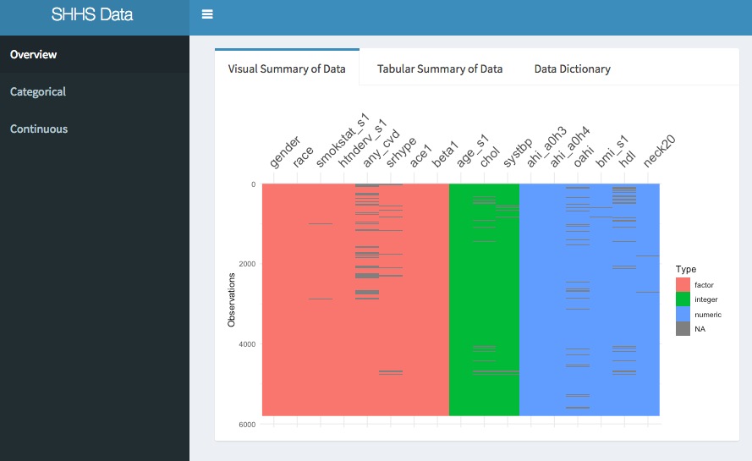
Data Explorer

Slide 20
Overview Tab
What values are missing from the dataset overall? (Visual Summary)
Are any numeric values skewed in distribution? (Tabular Summary)
How is the variable defined? (Data Dictionary)
What are the permissible values? (Data Dictionary)

Slide 21
Let’s try it!
How many categories are there for the Depressed variable? (in R, we call them factors)
How many missing cases are there for Depressed?
What is the mean age for the dataset?
How is the Depressed variable defined in this dataset?

Slide 22
What is the Category Tab for?
Should we add a categorical variable to our model?
Does my categorical variable have predictive value?
Does adding my variable affect the number of cases I can analyse?
Is my variable missing at random or not at random?
Is my categorical variable confounded with another categorical variable?

Slide 23
Categorical Tab
What percentages exist for my categorical variable? (Single Category)
Is my variable associated with outcome? (Category/Outcome)
Is my variable associated with other variables? (Crosstab)
Are the missing values of my variable evenly distributed? (Missing Data)

Slide 24
Categorical Example
Do people with the most days of LittleInterest also have the most days of Depression?

Slide 26
Categories: Let’s try it!
What is the category with the largest counts for Depressed?
Do the proportions of people with your outcome look the same for those who use marijuana versus those who don’t use it?

Slide 27
Why is the Data Missing?
Many reasons for the data being missing from a variable!
Data was not collected
People were excluded (why?)
Combinations of variables don’t make sense (structural zeros)
Cis-males and pregnant status

Slide 28
Things to Consider about Missing Data
How was the Data Collected?
Is there a discernable pattern to the values that are present vs. those that are missing?
Is there an underlying explanation for the missing values?
NA: When Missing Data is Valuable

Slide 29
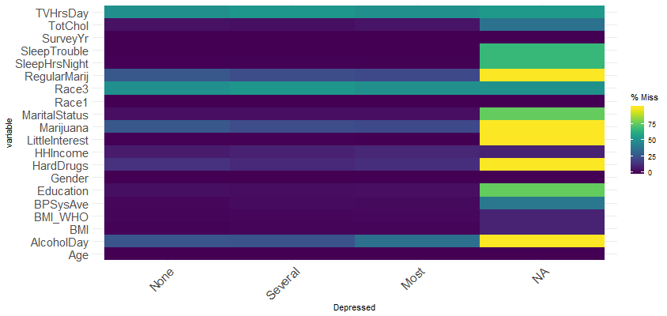
Assessing Missing Data: NaNiar

Slide 30
Look at percentages missing within combinations of categories
Highlight potential problematic relationships
Are we missing data where we least expect it?

Slide 31
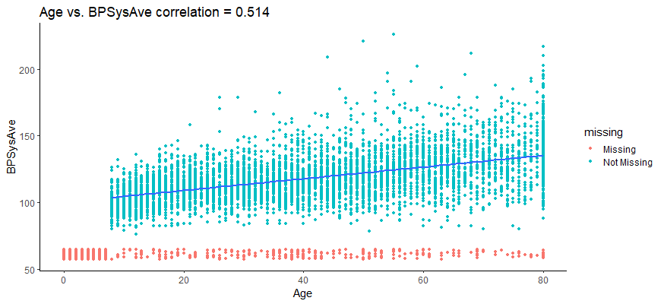
Assessing Missing Data: NaNiar

Slide 32
What do you do if the data is missing?
Depends on what you want to do:
Only look at rows that have everything (complete-cases)
Potentially can impute (replace) missing values
mean, median, mode (categorical)
Remove rows that have lots of missing information

Slide 33
Continuous Tab
What is the distribution of my categorical variable? (Single Continuous)
Is my continuous variable associated with outcome? (Continuous/Outcome)
Is my continuous variable associated with another categorical variable? (Boxplot)
Is my continous variable associated with another continous variable? (Correlation)
Is my continuous variable missing values? (Correlation)

Slide 34
Continuous Scatter
If you get less hours of sleep per night, does that mean you have a higher BMI?

Slide 36
Continuous Boxplot
If you have a lot of depressed episodes, do you also get less sleep?

Slide 38
Continuous: Let’s Try it!
Is there something strange about Age in the dataset?
As you get older, does your BMI go up?
Do Depressed people have a higher systolic blood pressure than non depressed people?

Slide 39
Depression Questions
Is there an association of LittleInterest with Depressed?
Is marijuana use associated with depression?
Is Hard Drug use associated with depression?
How are sleep and marijuana use related in the dataset?
Is there a relationship between Sleep hours and depression?
Is there a relationship between Sleep hours and Age?
Is there a relationship between hours TV watched and Depression?
Or, choose a question! It should look at least two variables.

Slide 40
Let’s learn from each other
Each group should present the findings from 1 interesting question:
What was your question?
What variables did you look at? How were they defined?
Where did you find it in the app?
What did you expect in terms of the relationship?
For another variable, assess the association of it with your non-outcome.
Did you find a relationship between your variable and outcome? Show the plot that convinced you and write one or two sentences about it.

Slide 41
Some Final Notes about NHANES
NHANES was designed with a very special sampling design, that was meant to be representative to the United States
There are weights that you must utilize for real modeling and analysis

Slide 42

Congratulations
You are now a full fledged data explorer!
https://waynepelletier.com/work/tasty-icons

Slide 43

Burro
R package that lets you explore your data:
http://laderast.github.io/burro

